Slide 1
Significance of Defensive Shift on MLB Offense
By: Angelina Allen, Trevor Owen, William Otting

Slide 2
Stage 1: Ask a Question

Slide 3
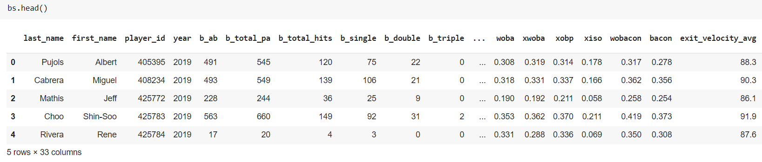
What is the dataset?
The dataset that we created is compiled from different variations of BaseballSavant and FanGraphs in xlsx and csv format. BaseballSavant, like FanGraphs, is a site dedicated to providing player matchups, Statcast metrics, and advanced statistics in a simple and easy-to-view way. A big part of our data collecting was from Statcast data through BaseballSavant. Statcast technology precisely tracks the location and movements of the ball and every player on the field, resulting in an unparalleled amount of information covering everything from the pitcher to the batter to baserunners and defensive players.

Slide 4
Questions, Expectations, and Benefit
Main Question: How significant of an impact does the shift play on success in the MLB offense?
Expectation: Our expectation as a group is to be able to find correlation between the two subjects in various aspects of the game. Ultimately we want figure out how much the game is affected by the growth of the shift.
Benefit: The benefit of this project is to gain an understanding of the game operations for groups like us who want a future in sports, Also, now with the shift rule change, this project can be added to in the future with more data when there is no shift at all.

Slide 5
Stage 2: Get the Data

Slide 6
How did we get the data?
We scraped our information from different datasets and gathered data about overall team offensive statistics, defensive shift statistics, and specific player offensive statistics based on hitting with a shift during the 2017 and 2022 seasons.
We looked at specific categories like batting average on balls playered (BABIP) and players with 10+ plates appearances (PA) and etc.
The primary dataset was comparing 2017 to 2022 (two full years of data) and their respective Shift % data, we added a column for win % to find the correlation the defining statistic that we would like to figure out.

Slide 7
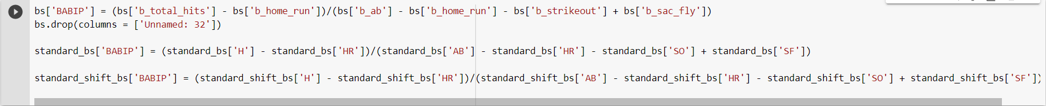
How did we clean/prepare the data?
We removed columns we didn't need for our project, like a random column that was just filled with null values in one of the datasets
We also added a few columns to data sets to make comparing a little easier, like adding a BABIP column for one.
df.isnotnull().any() for the main CSV

Slide 8
Stage 3: Explore the Data

Slide 9
Descriptive Analysis
The data is clear, shifts work. But not for every player or even every team. They aren’t the only contributing factor to the mitigation of offensive strategy, but the amount of offensive production has dropped significantly.
Not every team with a high shift % is successful, but the teams that are at the peak of win % do have the highest shift percentages
There has been an influx in shift % due to a more analytics-intensive approach
There is a more definitive and stable decrease of performance in left-handed batters than right-handed batters
There is a more definitive and stable decrease of performance in left-handed batters than right-handed batters

Slide 10
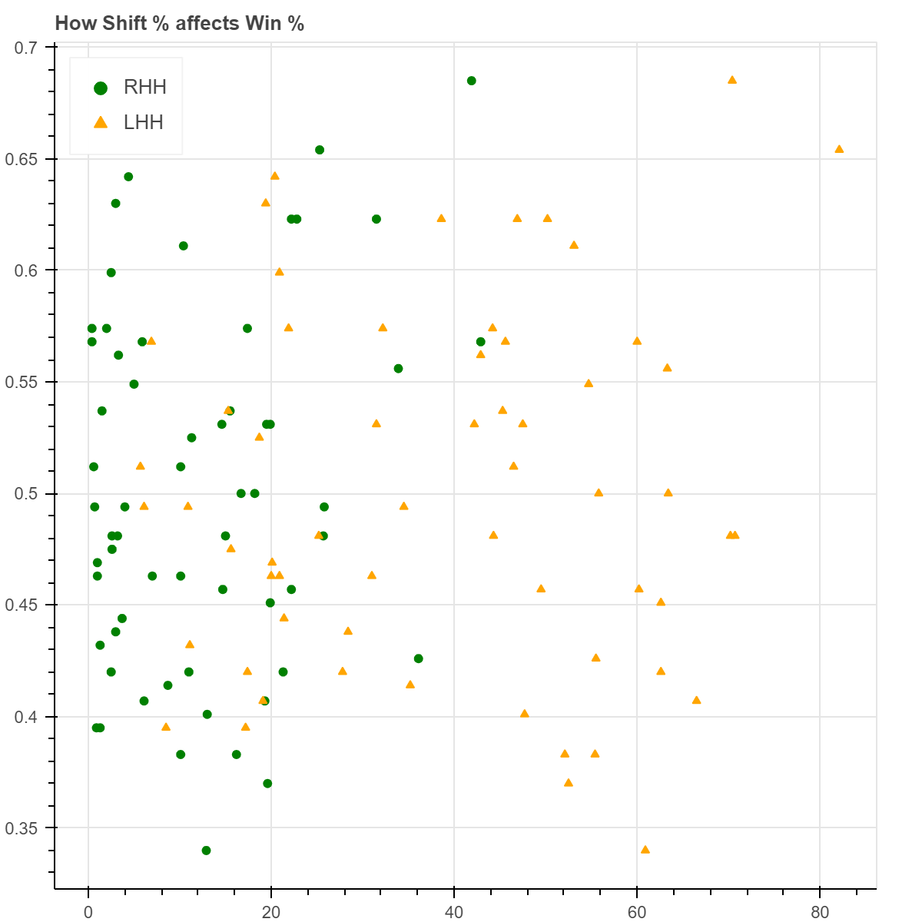
Successful and unsuccessful teams are all over the place…
The the threshold for minimum shift % for left handers to win 60% of your games is just under 20%
There are no teams with under a 55% win percentage with a 40%+ shift % against right handers (Why are there not more shifts against the RHH?)
Win %
The bottom left 3 grids contain a surplus of the data, and are evidence that not implementing a proper proportion of shifts lowers Win %
Shift %

Slide 11
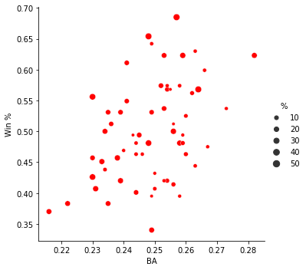
…However, unsuccessful teams with high shift percentages can attribute much of their failure to their deficiencies on offense (Low BA + High shift % = Low Win %)
The biggest Win % teams have relatively larger dots. There are exceptions to this, of course. But the large dots that are near the bottom do not typically have large shift percentages.
“%” designates overall shift percentages

Slide 12
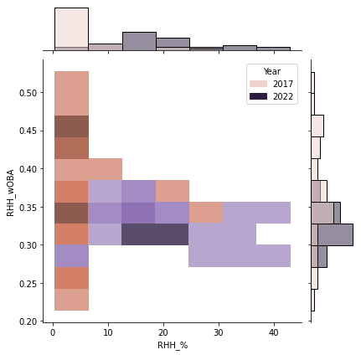
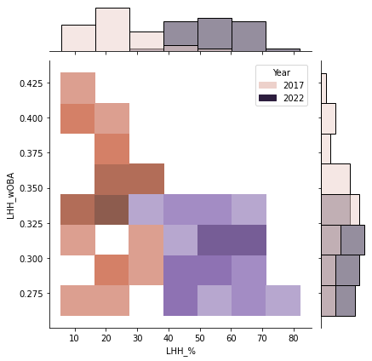
Left handed shift % increase leads to more definitive and convincing results
Left Handed Shift% leads to lower opposing batting average at a more sustainable rate
It explains why the proportions are so different, but it does not justify the questionably small increase in Shift % against right handers

Slide 13
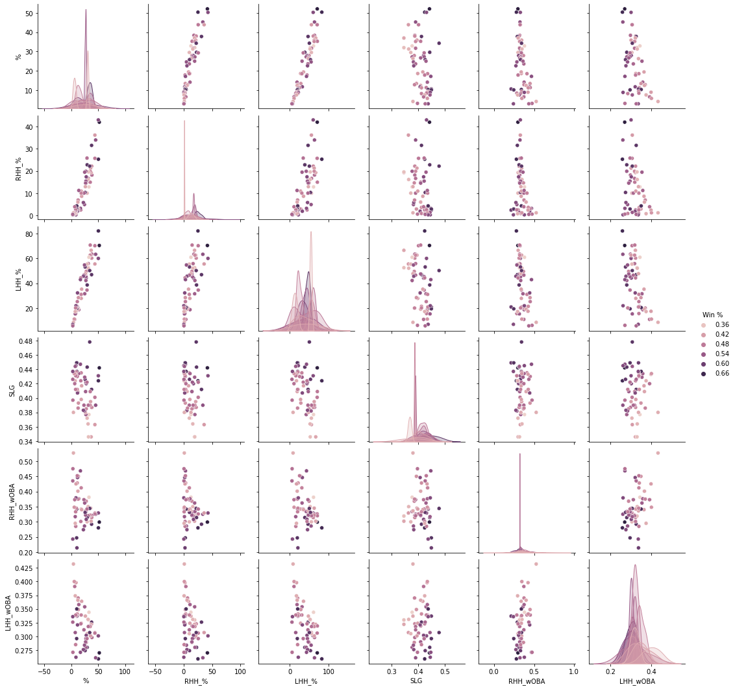
Not all teams who shift a lot win, but most of the best teams shift a lot
This is a pairplot to find general relationships/trends between data
The primary purpose of the visual is to illustrate that the darkest dots are at the top for shift percentages and offensive effectiveness

Slide 14
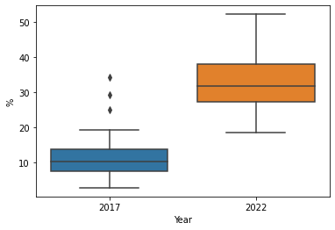
Shifts have significantly increased in the last 5 years…
A box plot for increases in shifts from 2017 to 2022

Slide 15
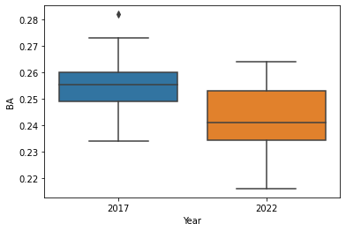
…At the same time, batting averages have dropped
A box plot for batting averages by year

Slide 16
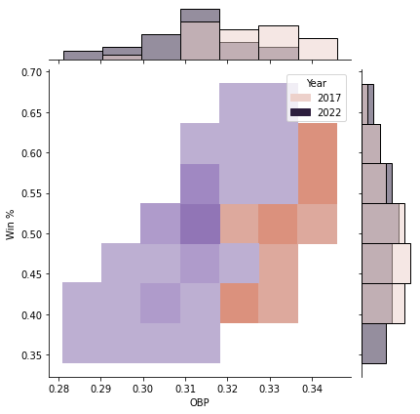
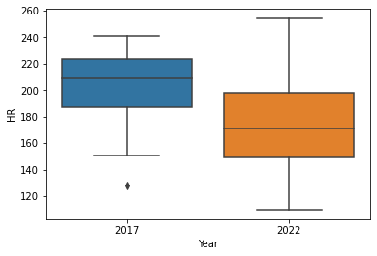
HR and OBP have both dropped significantly from 2017 to 2022
A histogram jointplot with the year as a hue to illustrate the decrease in OBP
A box plot for the decrease of HR by year

Slide 17
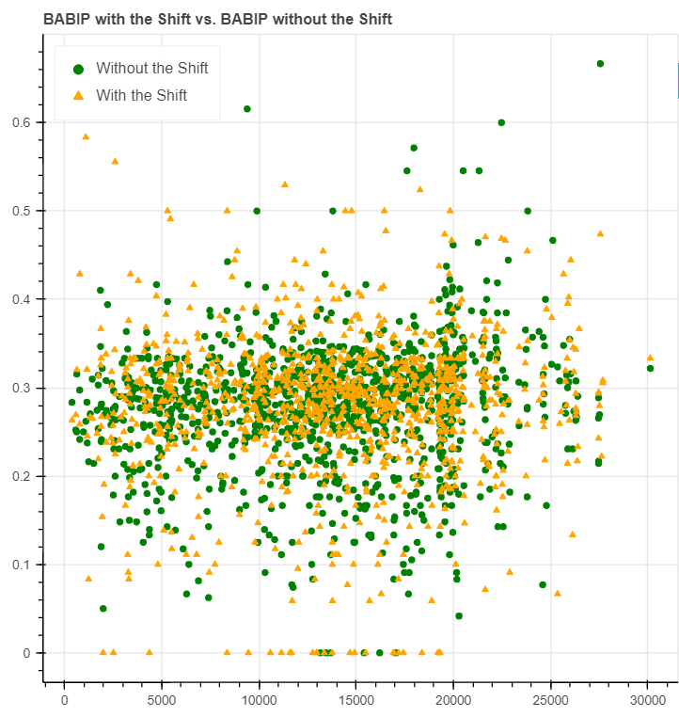
Effects on BABIP
How the shift effects batting average on balls in play of specific batters that have 10+ plate appearances.
This is the only graph that utilizes the other CSV files (not the main CSV)
**The highest offensive efficiency statistical outliers are mitigated by shifts

Slide 18
Hypothesis
H1: Shifts have an effect on every aspect of offense. They lower batting average, on base percentage, and change the tendencies/strategies of the players to lower overall home runs and increase strikeouts.
H2: Shifts are underutilized for right handed batters, increasing shift % stabilizes variance and creates a lower overall success rate for the batter.
H3: Shifts efficacy is amplified by the overall ability of the team. If the team is bad, no amount of shifts will change their performance. If the team is both offensively and defensively efficient, they will perform significantly better.

Slide 19
Problems with the Data
We believe the main issue with our data is that there are locational/positional limitations to the shift data. How far does someone shift for a certain batter? What is the optimal location for the shift? Does every team utilize the optimal location? The ambiguous nature of the classification makes it difficult to make any assertions.
What could possible make it better is just more information/data. Also, now with the new rule change we will be able to have a whole new perspective of data that embodies a time where no shifts are allowed at all.

